Slide 1

Human Detection & Counting
Anto Francis 095
Sachin Sreekumar 096
S.V. Aasheesh 110

Slide 2
Contents
Objective
Modules
Working
Use Case
Limitations
Future Scope
Requirements
Challenges

Slide 3
Objective
To build a Human Detection system with counting mechanism.

Slide 4
Requirements
Python IDE
Open cv2 Library
Imutilis Package
Argparse Package

Slide 5
Modules

Slide 6
Modules
Arg Parse Module
Input Identification Module
Human Detection Module
Detection and Counting in live video
Detection and Counting in uploaded video
Detection and Counting in uploaded image

Slide 7
Arg Parser Module
Makes User friendly command line interfaces
Program specifies the arguments required and arg parser determines how to extract them.
Generate help and usage messages

Slide 8
Input Identification Module
Identifies which input is taken i.e. webcam, uploaded video or image
-v : For Video input
-c : For camera input/Webcam
-i : For image as in input
After identification, input arguments is given to the specific module.

Slide 9
Human Detection Module
HOG (Histogram of Oriented Gradients) Descriptor
Extract features from images.
Commonly used in Computer Vision and Object detection
Calculate the magnitude and direction of each pixel values.
A histogram is created from the data which is the features extracted from the image.

Slide 10
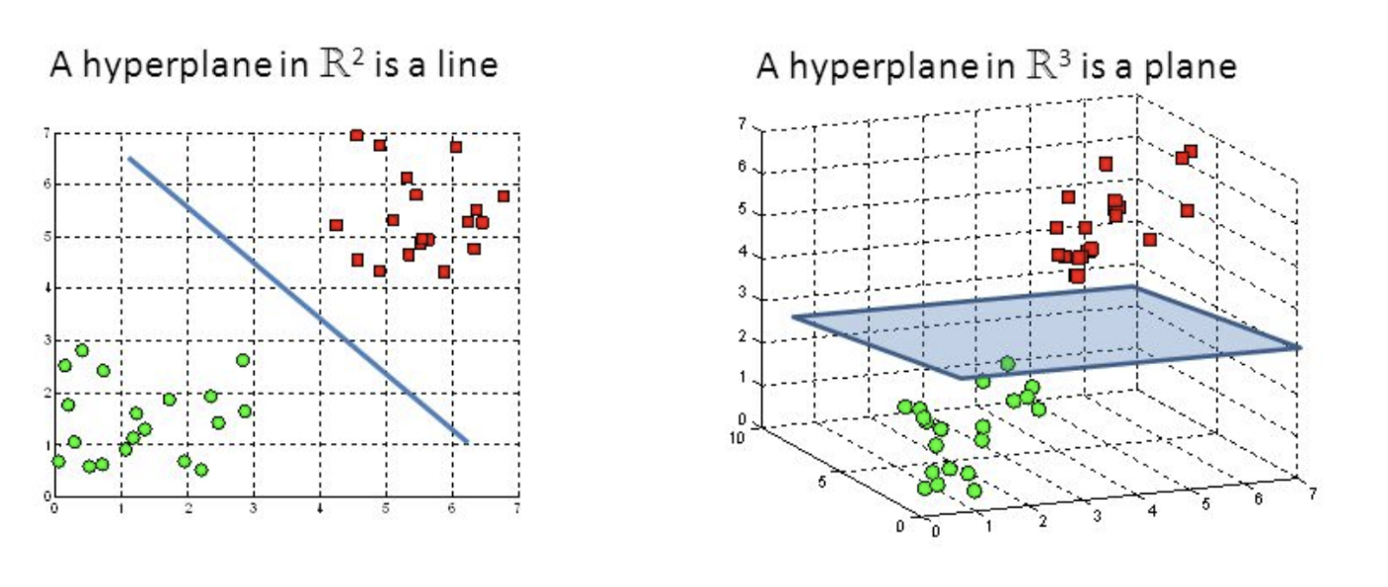
Human Detection Module
SVM Classifier
Supervised Learning Algorithm
Classify datapoints based on hyperplanes.

Slide 11
Flow Chart
Video
Input Identif-ication
Input
Human Detection
Output
Image
Webcam

Slide 12
Challenges
Unable to save output file
At times video camera does not open

Slide 13
Use Cases

Slide 14
Use Cases
Used as Surveillance system.
Abnormal Event Detections
Congestion Analysis
Person Identification
Gender Classification
Fall Detection

Slide 15
Limitations

Slide 16
Limitations
The Project currently detects only the presence of Humans in the frames.
Video format saved sometimes don’t work due to some error.
Delay in processing of the input.
In video input, count of people getting detected is not being stored currently, it is getting updated in real-time.

Slide 17
Future Scope

Slide 18
Future Scope
In Detail Implementation:
Abnormal Event Detections
Congestion Analysis
Person Identification
Gender Classification
Fall Detection

Slide 19
Thank You!
Questions?

